Slide 1
UTILITY SCORING OF PRODUCT REVIEWS
Team MARS Instructor Dr.Vineet Gandhi M.Sravan TA Aryaman Gupta
Akhil.R
Rama Rohit Reddy.G
Sudheer.A

Slide 2
Overview
Problem Definition
Datasets
Approach
Evaluation Metrics
Experiments
Results
Analysis and conclusions

Slide 3
Problem Statement
Utility is the usefulness or reliability of a given review. Utility score is the score given to a review based on its usefulness from 0 to 1.
Utility score prediction of a review belonging to particular category
Utility score prediction of a review of unknown category
Classification Given an unknown review, predict its category.
Utility Score prediction Train a model to predict the utility score of a review.

Slide 4
Datasets
We downloaded reviews and related data in 22 different domains like Electronics, Clothing, Sports,Video games etc from amazon product data(http://jmcauley.ucsd.edu/data/amazon/)
The datasets consist of Customer Reviews, Helpfulness Numerator,Helpfulness Denominator.
Utility of a review is calculated as score=Helpfulness Numerator/Helpfulness Denominator.

Slide 5
Approach
Text normalization
Feature extraction
Classification
Learning algorithms

Slide 6
Features
Lexical Similarity Features GMM Clustering based on proper nouns and number of words between them in order to find the originality of a review.

Slide 7
Features(continued)
Shallow Syntactic Features
Proper nouns
Numbers
Modal Verbs
Interjections
Comparative and Superlative adjectives
Comparative and superlative adverbs
Wh Words

Slide 8
Features(continued)
Lexical Subjectivity clues
Dynamic adjectives (e.g., “careful”, “serious”).
Polarity Plus and Minus adjectives (e.g., “amusing”, “awful”)
Gradability Plus and Minus adjectives (e.g., “appropriate”)
Weak and strong Subjective Nouns
Weak and strong Subjective

Slide 9
Classification
Classify a given review into one of the 22 categories using:
Neural Networks Architecture
Embedding layer with the size of vocabulary.
1-D convolutional layer with 32 filters of size 3 with relu activation.
Max pooling 1-D layer with pool size 2
Fully connected layer with relu activation function.
Fully connected layer with 22 nodes and softmax classifier.
Adjectives Certain adjectives are used to describe specific categories. Generated adjectives for each category using a seed set and recursively adding all its synonyms. Using these adjective list we predict the category of a review using the count of the adjectives or its synonyms as the only feature. The category with maximum count is the class of the given review.
Voted Classifier Ensemble of 5 models(SVM,Decision Tree,Naive Bayes etc)to classify a given review using its TF-IDF vector.

Slide 10
Learning Algorithms
Support Vector Regression (-SVR)
Simple linear regression (SLR)

Slide 11
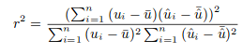
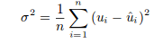
Evaluation metrics
Squared correlation coefficient Squared correlation coefficient is a statistic that will give some information about the goodness of fit of a model. In regression, the R2 coefficient of determination is a statistical measure of how well the regression line approximates the real data points.
Mean Square Error

Slide 12
Experiments
Utility Score Prediction with known category
Train the models to predict utility scores using three types of features separately:
Lexical similarity
Shallow syntactic
lexical subjective
Combining Shallow syntactic and lexical subjective features to predict the score of a review.
Combining all the above features to predict the score of a review with known category.

Slide 13
Experiments(Continued)
Prediction of category of an unknown review
Train a neural network to predict the category of a review with unknown category.
Using specific adjectives and their count as features to predict category.
Voted Classifier of models to predict category:
Decision Tree
Naive Bayes
SVM
Logistic Regression
Once The category is predicted, it is considered as a known category and the previous experiments are repeated.

Slide 14
Experiments(Continued)
Prediction of category of an unknown review:
Instead of predicting the category of review , we trained a regression model using reviews from all the categories.

Slide 15
Results
Some of the scores predicted and their errors are given below in the table and their corresponding graphs in the next few slides. All results are clearly given in report again. EXPERIMENT 1(known categories)
Type | SLR(SCC) | SLR(MSE) | SVR(SCC) | SVR(MSE)
Automotives | 0.0135 | 0.0518 | 0.0081 | 0.0458
Beauty | 0.0308 | 0.0386 | 0.0056 | 0.0403
Office Products | 0.027 | 0.013 | 0.0006 | 0.02
Pet Supplies | 0.025 | 0.027 | 0.0001 | 0.02976
Clothing Shoes and Jewellery | 0.0032 | 0.0156 | 0.0005 | 0.019

Slide 16
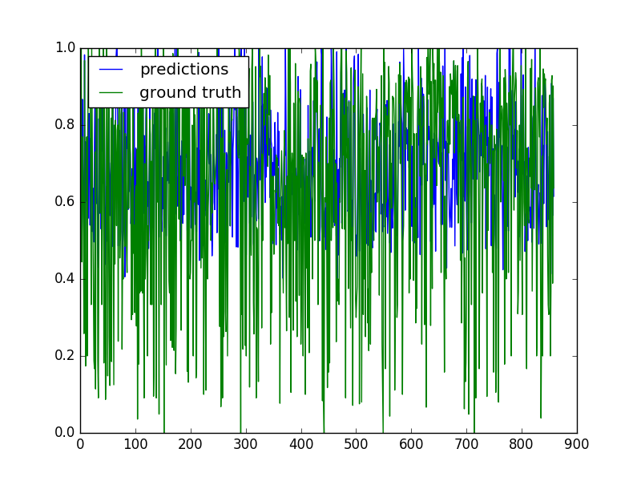
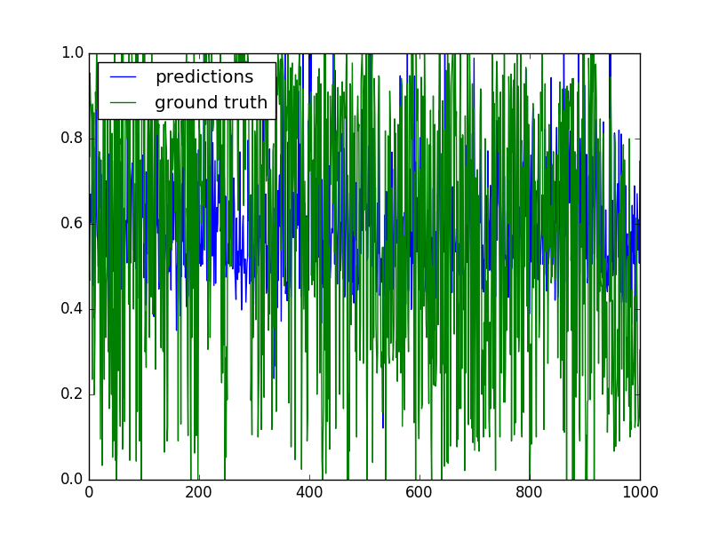
Digital Music (SLR) Movies and TV(SLR)

Slide 17
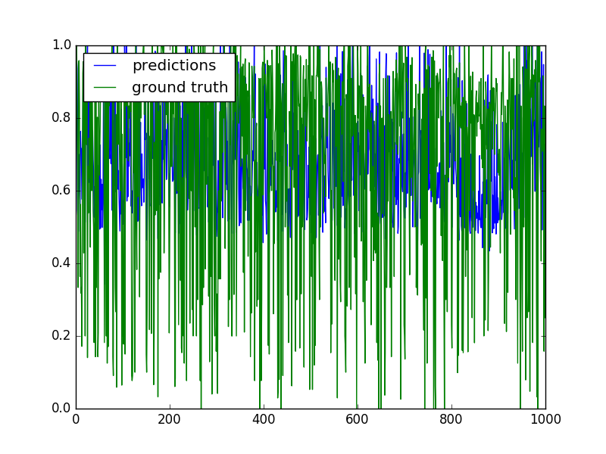
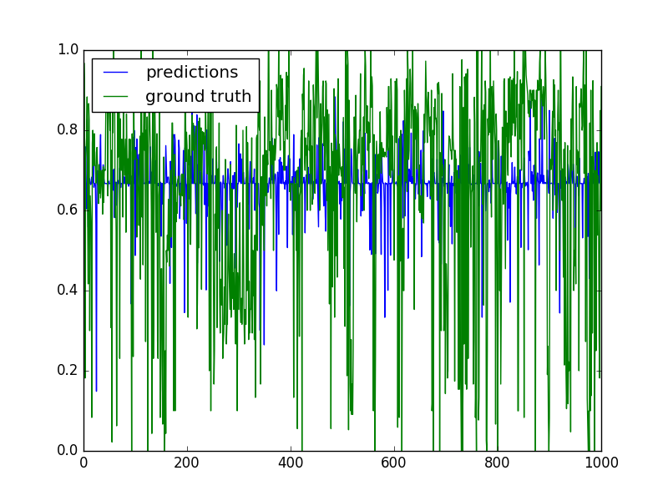
Video Games(SLR) Apps for Android(SVR)

Slide 18
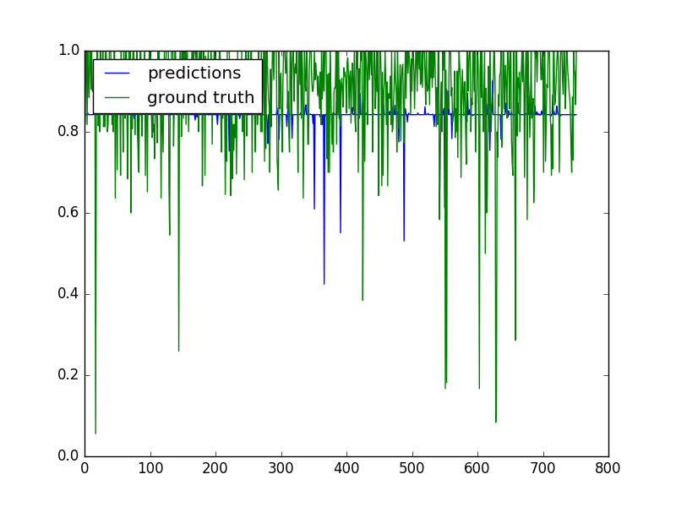
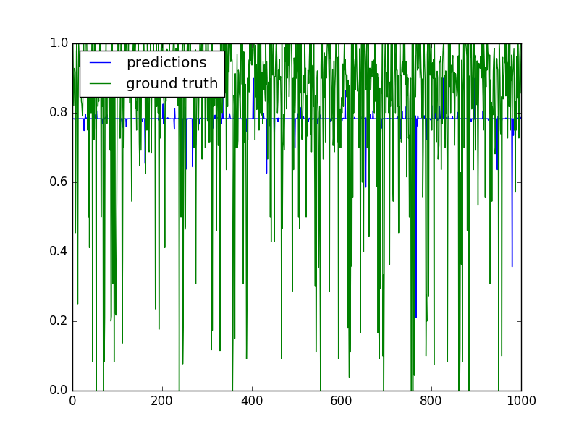
Clothing and Jewellery(SVR) Sports and Outdoors(SVR)

Slide 19
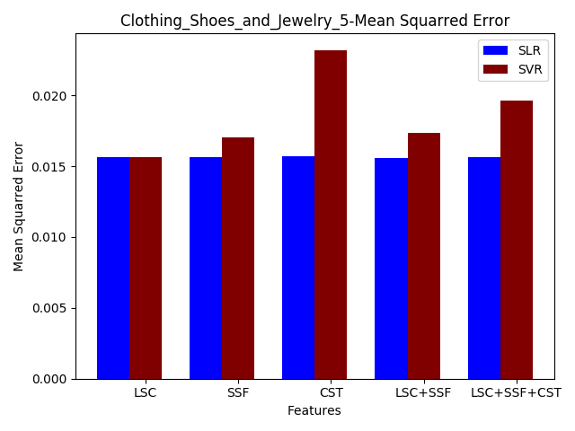
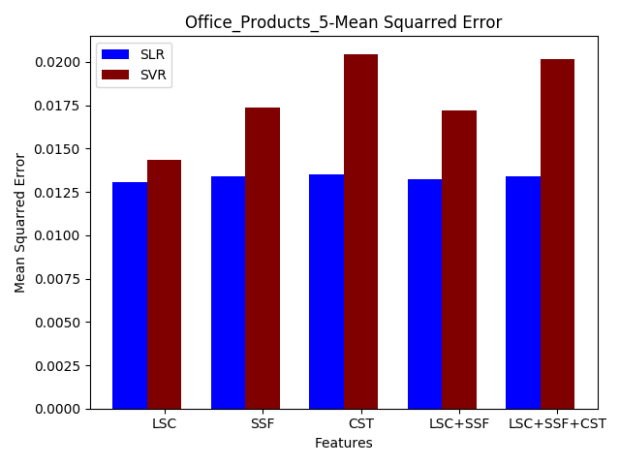

Slide 20
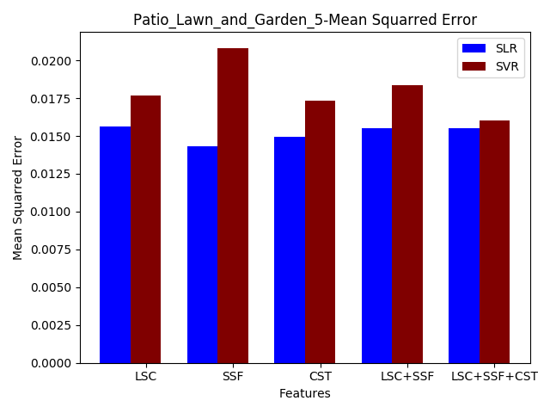
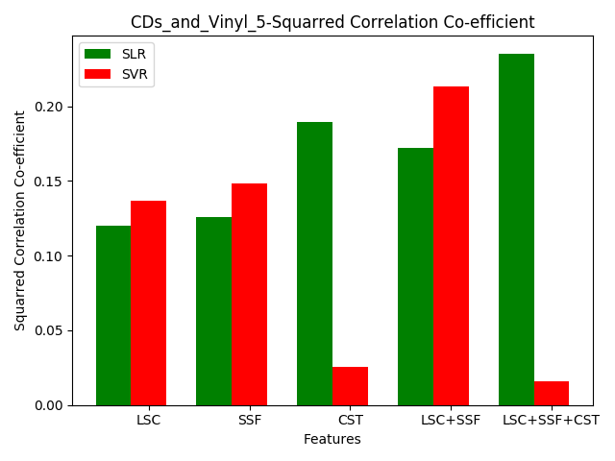

Slide 21
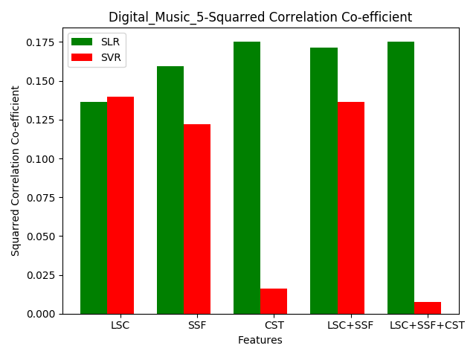
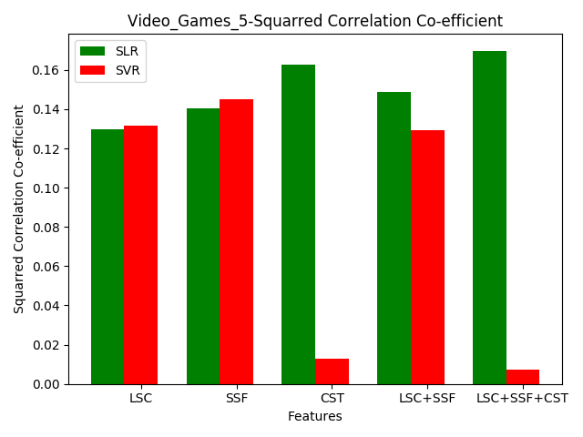

Slide 22
Results of regression model trained using reviews from all the categories, instead of predicting the category of review ,
Features | SLR(SCC) | SLR(MSE) | SVR(SCC) | SVR(MSE)
Shallow syntactic Features | 0.065393 | 0.0544 | 0.0368 | 0.575
Lexical Subjective Clues | 0.0332 | 0.0562 | 0.0095 | 0.0611
Clustering | 0.040 | 0.042 | 0.0106 | 0.0486
Shallow Synatactic + Lexical Subjective | 0.0710 | 0.0541 | 0.0518 | 0.05690
Shallow Syntactic +Lexical Subjective + Clustering | 0.0433 | 0.04199 | 0.058 | 0.0436

Slide 23
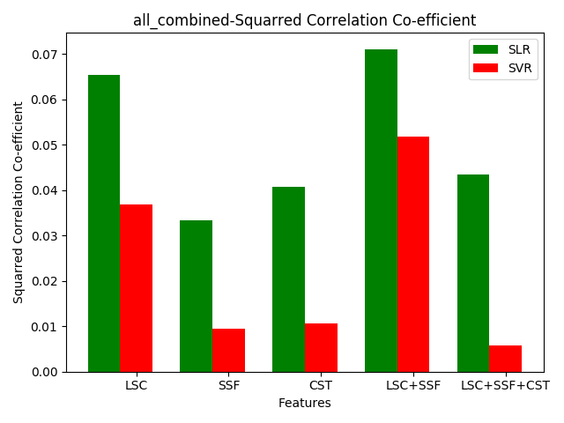
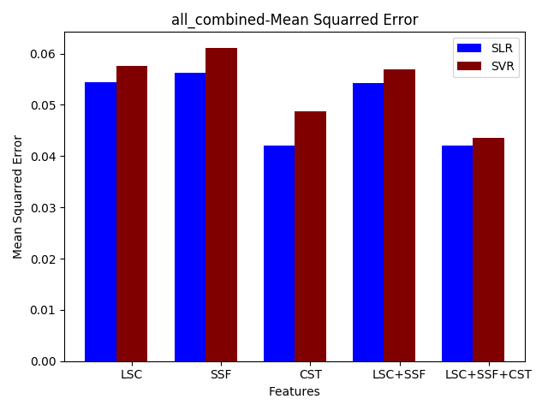

Slide 24
Predicting utility scores of unknown categories after classification
Accuracies various models used for predicting the category :
Neural Networks:70.036
Using Adjectives:45.36
Voted Classifier:82.32
SLR(SCC) | SLR(MSE) | SVR(SCC) | SVR(MSE)
0.4698 | 0.0330 | 0.1380 | 0.0515

Slide 25
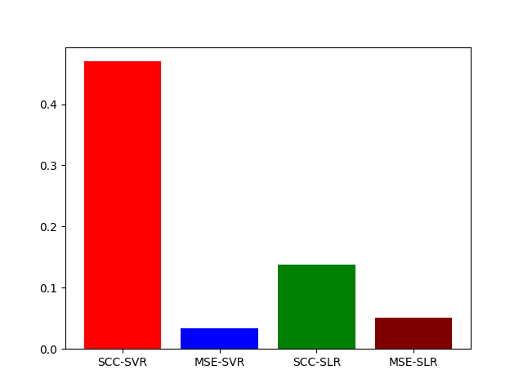
MSE and SCC after classifying reviews
and predicting utility scores using corresponding models

Slide 26
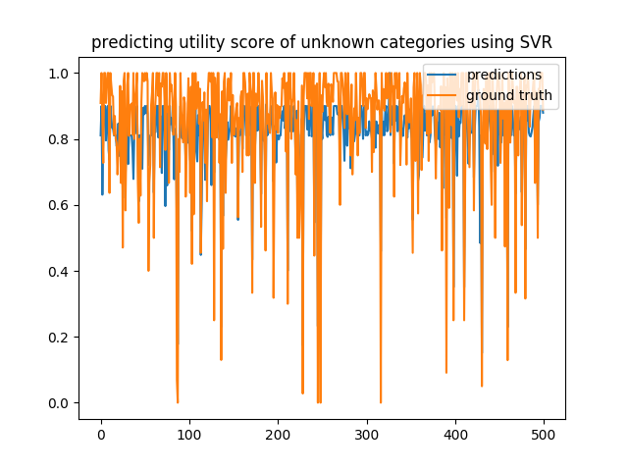
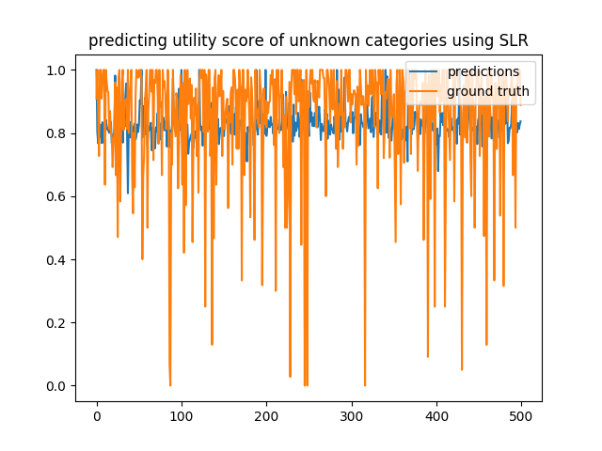

Slide 27
Analysis and Conclusions
Classification
Accuracy in classification is highest in the case of Voted Classifier.
Voted classifier has the advantage of testing a review with 5 different classifiers.
Neural networks also works good but less accurate than voted classifier.
The naive method of counting number of matches in adjectives does not work well as there is no learning based in this method and also it is ambiguous
Score Predictions
Each of the 5 models used for predicting the scores individually gives satisfactory results on particular type of data.
Since the description and grammar used by users vary, the accuracies of classifier will depend highly on the data given. Thus, we can see that the predictor with combination of all features gives better accuracy than single feature predictors.
Adding lexical similarity features was effective.

Slide 28

Thank You !

